Slide 2
TEAM SIZA
- Service request tracker (a single, customer-friendly interface)

Slide 3
Innovation & Impact
Does the solution demonstrate innovation, whether through disruptive change or meaningful incremental improvement? Does it introduce a new/enhanced element that delivers tangible impact?
Feasibility
Can the solution be realistically developed and implemented using current tools, technologies, or resources
Problem-Solving Effectiveness
Does the solution address a clearly defined need/challenge? Is the problem well understood, is the proposed approach effective in resolving it?
Scalability & Sustainability
Can the solution grow and adapt over time? Is it designed to remain relevant and useful in the long term?
User Experience
Is the solution intuitive, accessible & user-friendly? Does the design support ease of use and engagement?
Value & Return on Investment (ROI)
Does the solution demonstrate measurable value—financial or otherwise? Is there clear evidence of impact or benefit?

Slide 4
INTRODUCTION Introduce a single, customer-friendly interface (within the app and chatbot) where users can:
1.Track Service Requests (SRs) – for things like debit order disputes, refunds, payment holiday etc. - Priority (70%) - Fraud Follow Ups - Highest SRs - Repeat Calls 2. Track Applications – credit cards, loans, overdrafts, VAF, etc – Secondary (30%)

Slide 5
PROBLEM STATEMENT
- Application follow-Up
• Customers don’t know where they stand with applications or requests.
• They call in or go to branches just to ask: “Has it been approved?” or “What’s still needed?”
• Lack of visibility causes frustration, delays, and sometimes loss of business to competitors.
• Feel frustrated due to the lack of real-time updates. Shows all requests submitted (linked to account or via reference number).
Real-time statuses: Received, In Progress, More Info Needed, Resolved, etc. ______ Push notification when status changed only In-App ,agent name
• Notes or feedback shown for each_______ easy and attachment, ID and Busi Reg
Drop down option, SR, Application and Card
• Pending Documents (with upload link) email address
Approved / Declined______ * Reason
• Offer Sent / Agreement Needed_____________Contract / If application is declined, give feedback or tips for future success

Slide 6
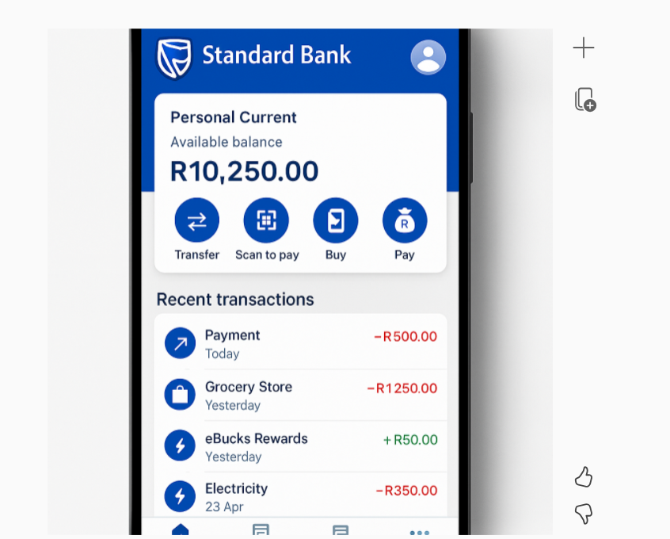

Slide 9
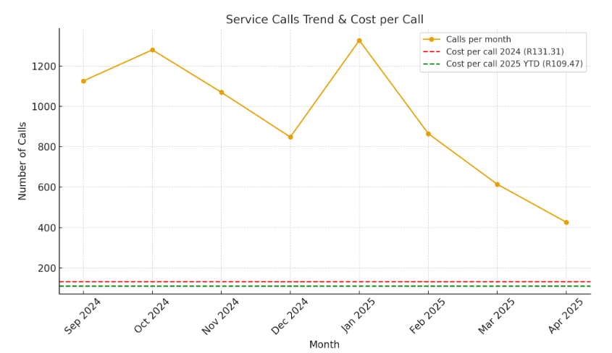
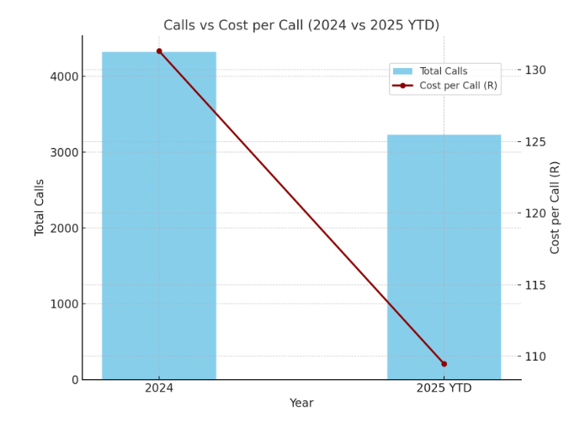
The orange line shows monthly call volumes (Sep 2024 – Apr 2025). The red dashed line marks the 2024 cost per call (R131.31). The green dashed line marks the 2025 YTD cost per call (R109.47).
Blue bars = total calls (2024 full year vs 2025 YTD).Red line = cost per call in each period. This makes it very clear that while call volumes dropped in 2025 YTD, the cost per call also improved significantly (from R131.31 to R109.47). This clearly shows that while call volumes have dropped, the cost per call has also improved.

Slide 14






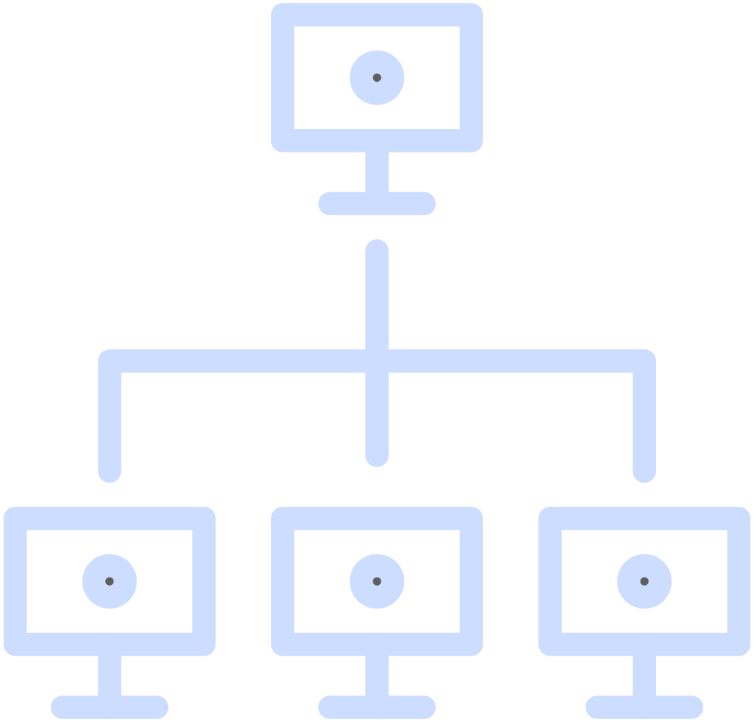


















Slide 15

Jodian van aarde
Prestige Banker, Acquisitions - PPBSA
Simmonds, Johannesburg

